Slide 1
“Immigration and Welfare Attitudes: Do Personal Interactions Matter?”
Hang Qi & Jake Haselswerdt
Harry S Truman School of Government and Public Affairs
University of Missouri

Slide 2

Immigration and Support for Redistribution
The actual or perceived influx and presence of immigration have become an important factor in determining welfare support (Alesina, Miano, and Stantcheva 2023; Burgoon and Rooduijn 2021; Garand, Xu, and Davis 2017).
How does the presence or the size of immigrant populations affect welfare attitudes and the welfare state?

Slide 3
Immigration and Support for Redistribution: Our Arguments
For immigration to affect welfare attitudes, citizens must first recognize their racial or ethnic contexts and then perceive out-groups as threats to resources or people to trust and sympathize with.
During this process, different types of personal interactions have considerable effects on citizens’ welfare attitudes and perceptions about immigrant participation in welfare programs:
Mere exposure (the frequency with which a citizen sees or encounters people they perceive to be immigrants).
Actual contact (the frequency with which they engage in conversation with people they perceive to be immigrants).

Slide 4
Hypotheses (condensed)
Frequent mere exposure will have a negative effect on support for social welfare.
Frequent actual contact will have a positive effect on support for social welfare.
Mere exposure and actual contact will condition effects of information about immigrant eligibility on welfare support.

Slide 5
Research Design and Data
Data Source: 2022 Cooperative Election Study (CES), a nationally representative survey run by the survey firm YouGov.
Dependent Variable: Support for Medicare-for-All (5-point scale).
Three Treatment Groups:
The “all immigrants eligible” group
The “only documented immigrants eligible” group
The control group (no mention of immigrants)
Preregistration Project:
Conditioning effects hypotheses pre-registered in the Open Science Framework Registry prior to the receipt of the data.

Slide 6
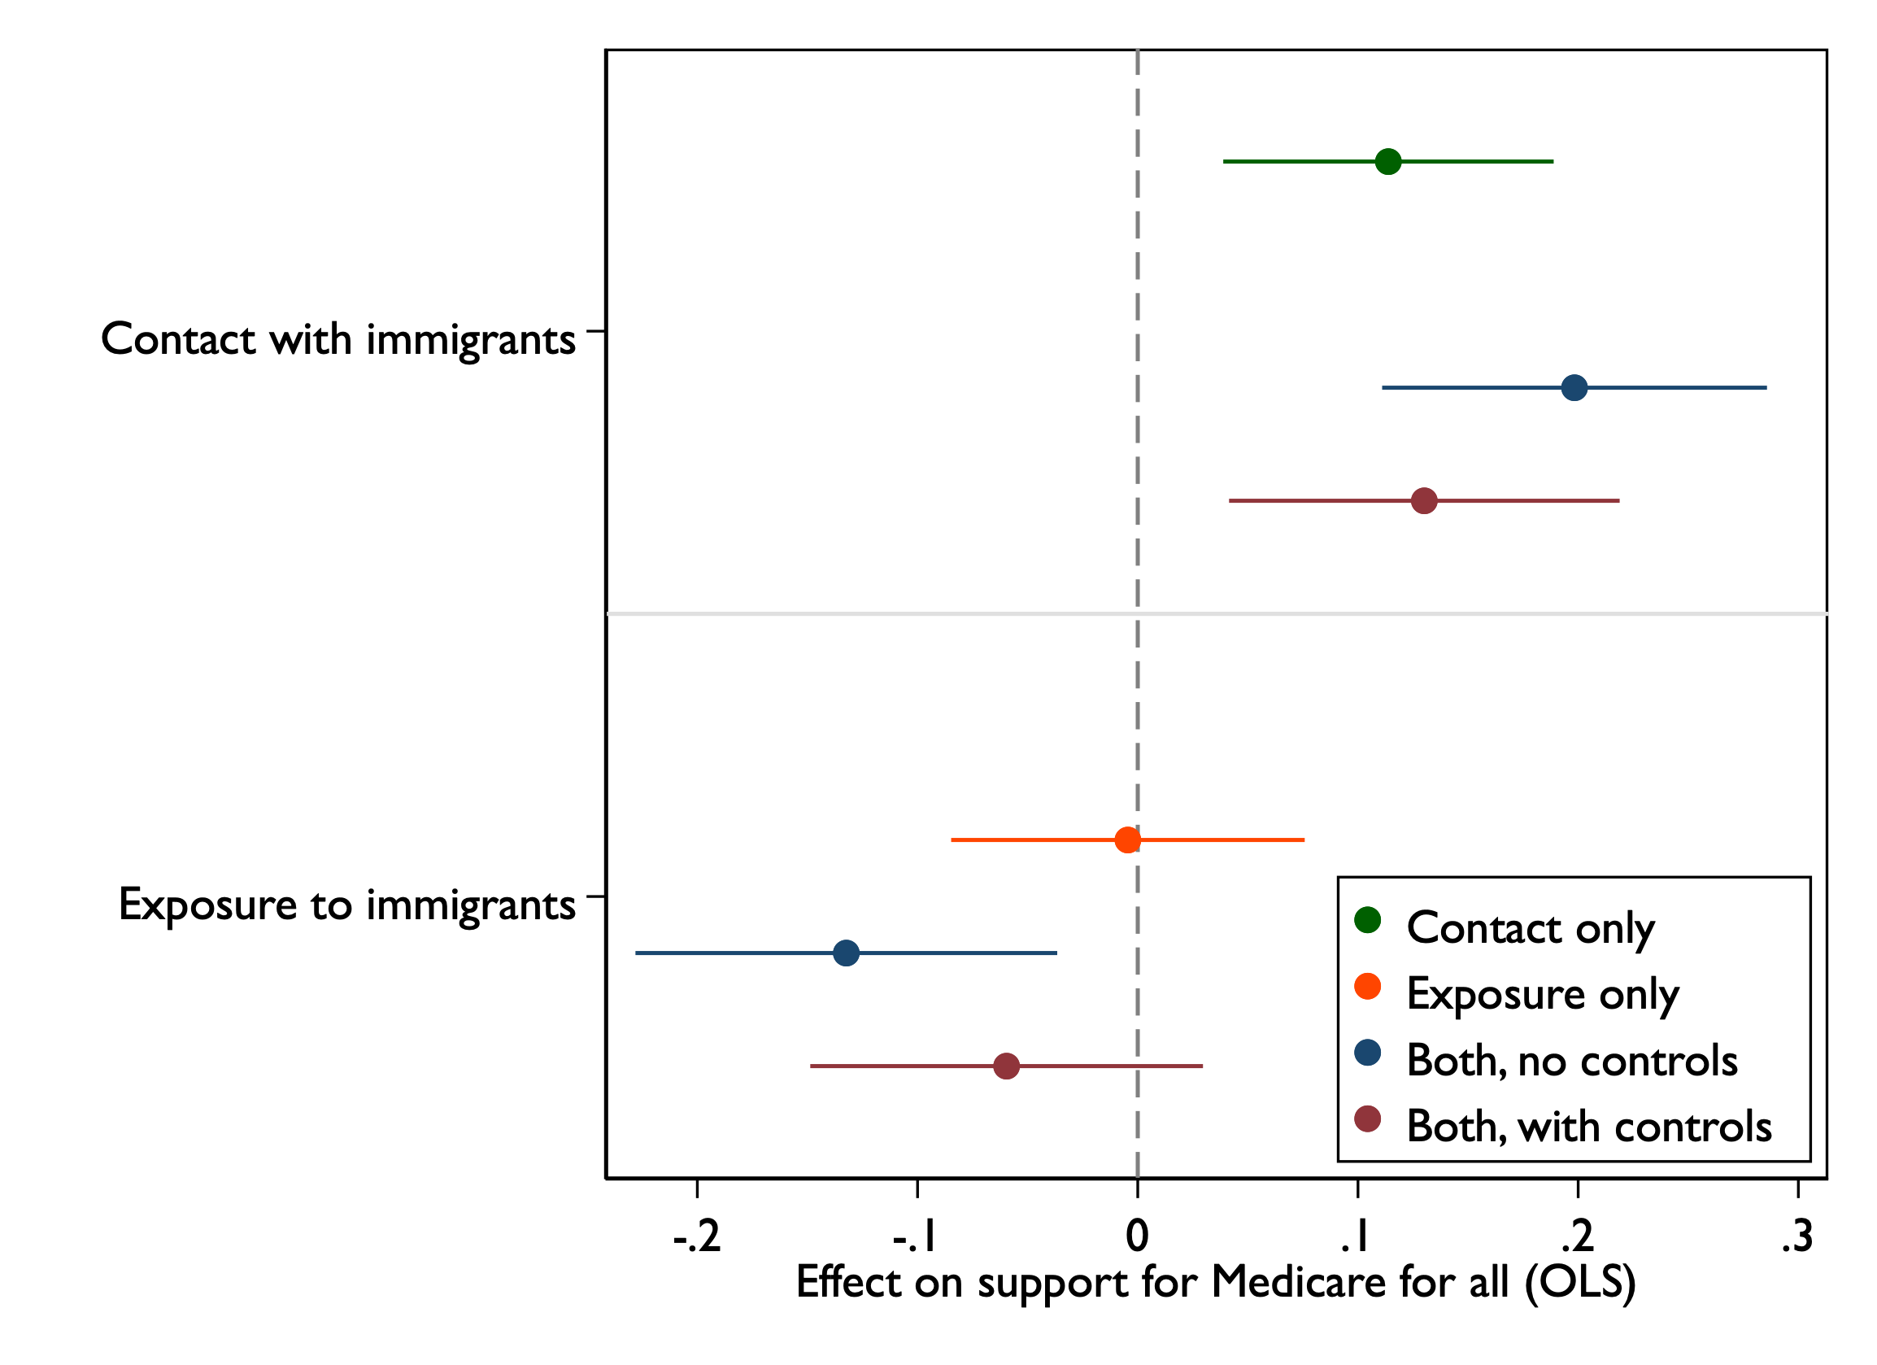
Contact with and exposure to immigrants and welfare support

Slide 7
“Immigration and Welfare Attitudes: Do Personal Interactions Matter?”
THANKS

Slide 8
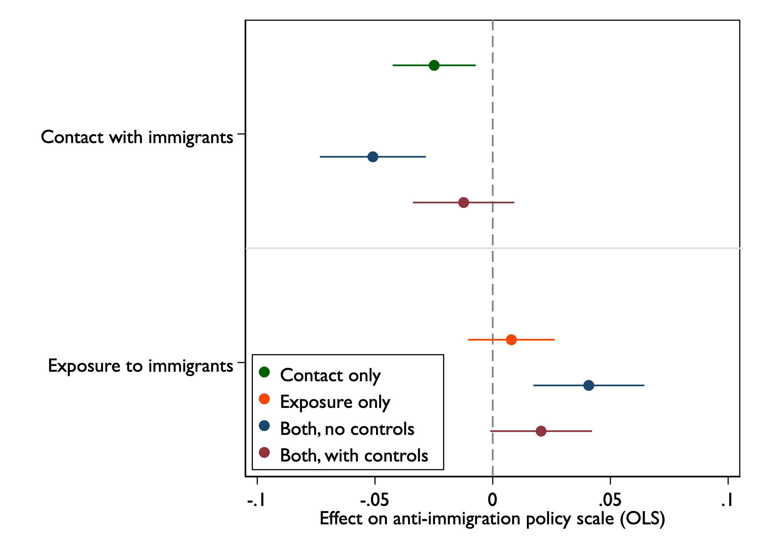
Contact with and exposure to immigrants and anti-immigrant policy attitudes

Slide 9
Conditional Effects of Immigrant Eligibility Treatments
 | (1) MFA support | (2) MFA support | (3) MFA support | (4) MFA support
Frequent actual contact | 0.30* (0.17) | 0.29* (0.17)
Frequent mere exposure |  |  | -0.30 (0.34) | -0.31 (0.34)
Combined immigrant treatment | -0.30** (0.13) |  | -0.30*** (0.11)
Combined immigrant treatment X Frequent actual contact | -0.02 (0.21)
Combined immigrant treatment X Frequent mere exposure |  |  | -0.09 (0.39)
All immigrant treatment |  | -0.46*** (0.14) |  | -0.43*** (0.12)
All immigrant treatment X Frequent actual contact |  | 0.05 (0.26)
All immigrant treatment X Frequent mere exposure |  |  |  | -0.23 (0.43)
Documented immigrant treatment |  | -0.16 (0.15) |  | -0.19 (0.13)
Documented immigrant treatment X Frequent actual contact |  | -0.09 (0.25)
Documented immigrant treatment X Frequent mere exposure |  |  |  | 0.03 (0.43)
Observations | 924 | 924 | 918 | 918
Adjusted R-squared | 0.390 | 0.394 | 0.387 | 0.391
Coefficients are OLS regression with control variables and weighted data. Standard errors in parentheses.
* p<0.10, ** p<0.05, *** p<0.01

Slide 10
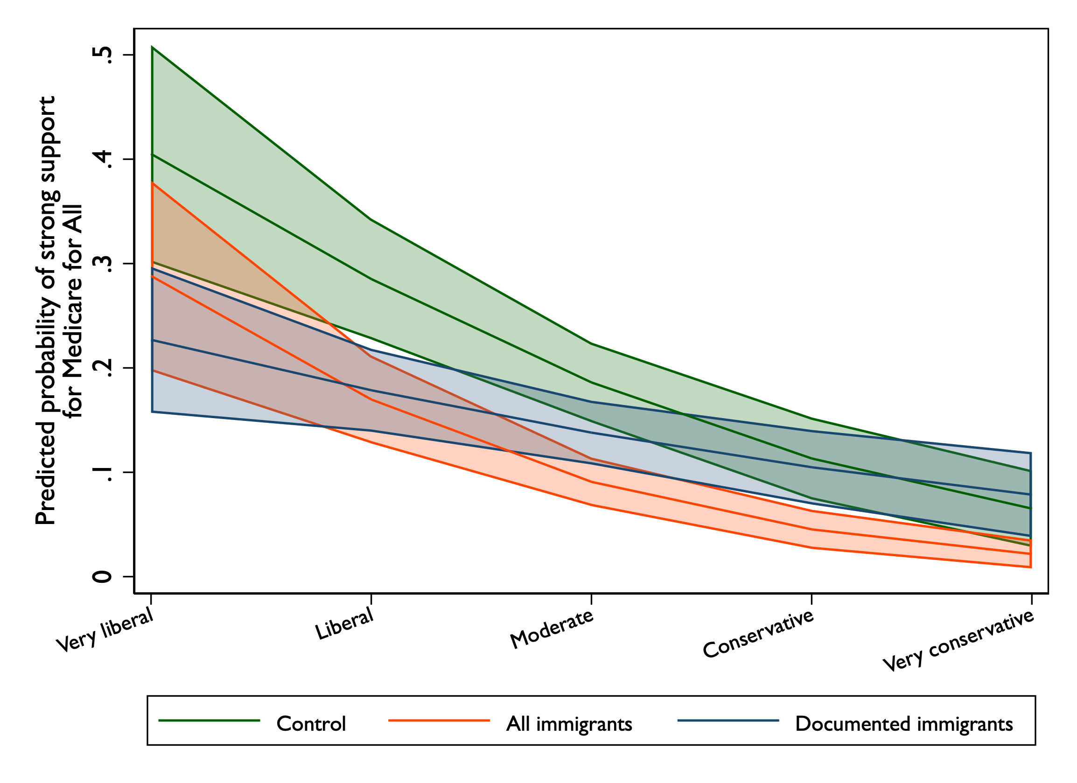
Conditional Effect Results (Ideology)

Slide 11
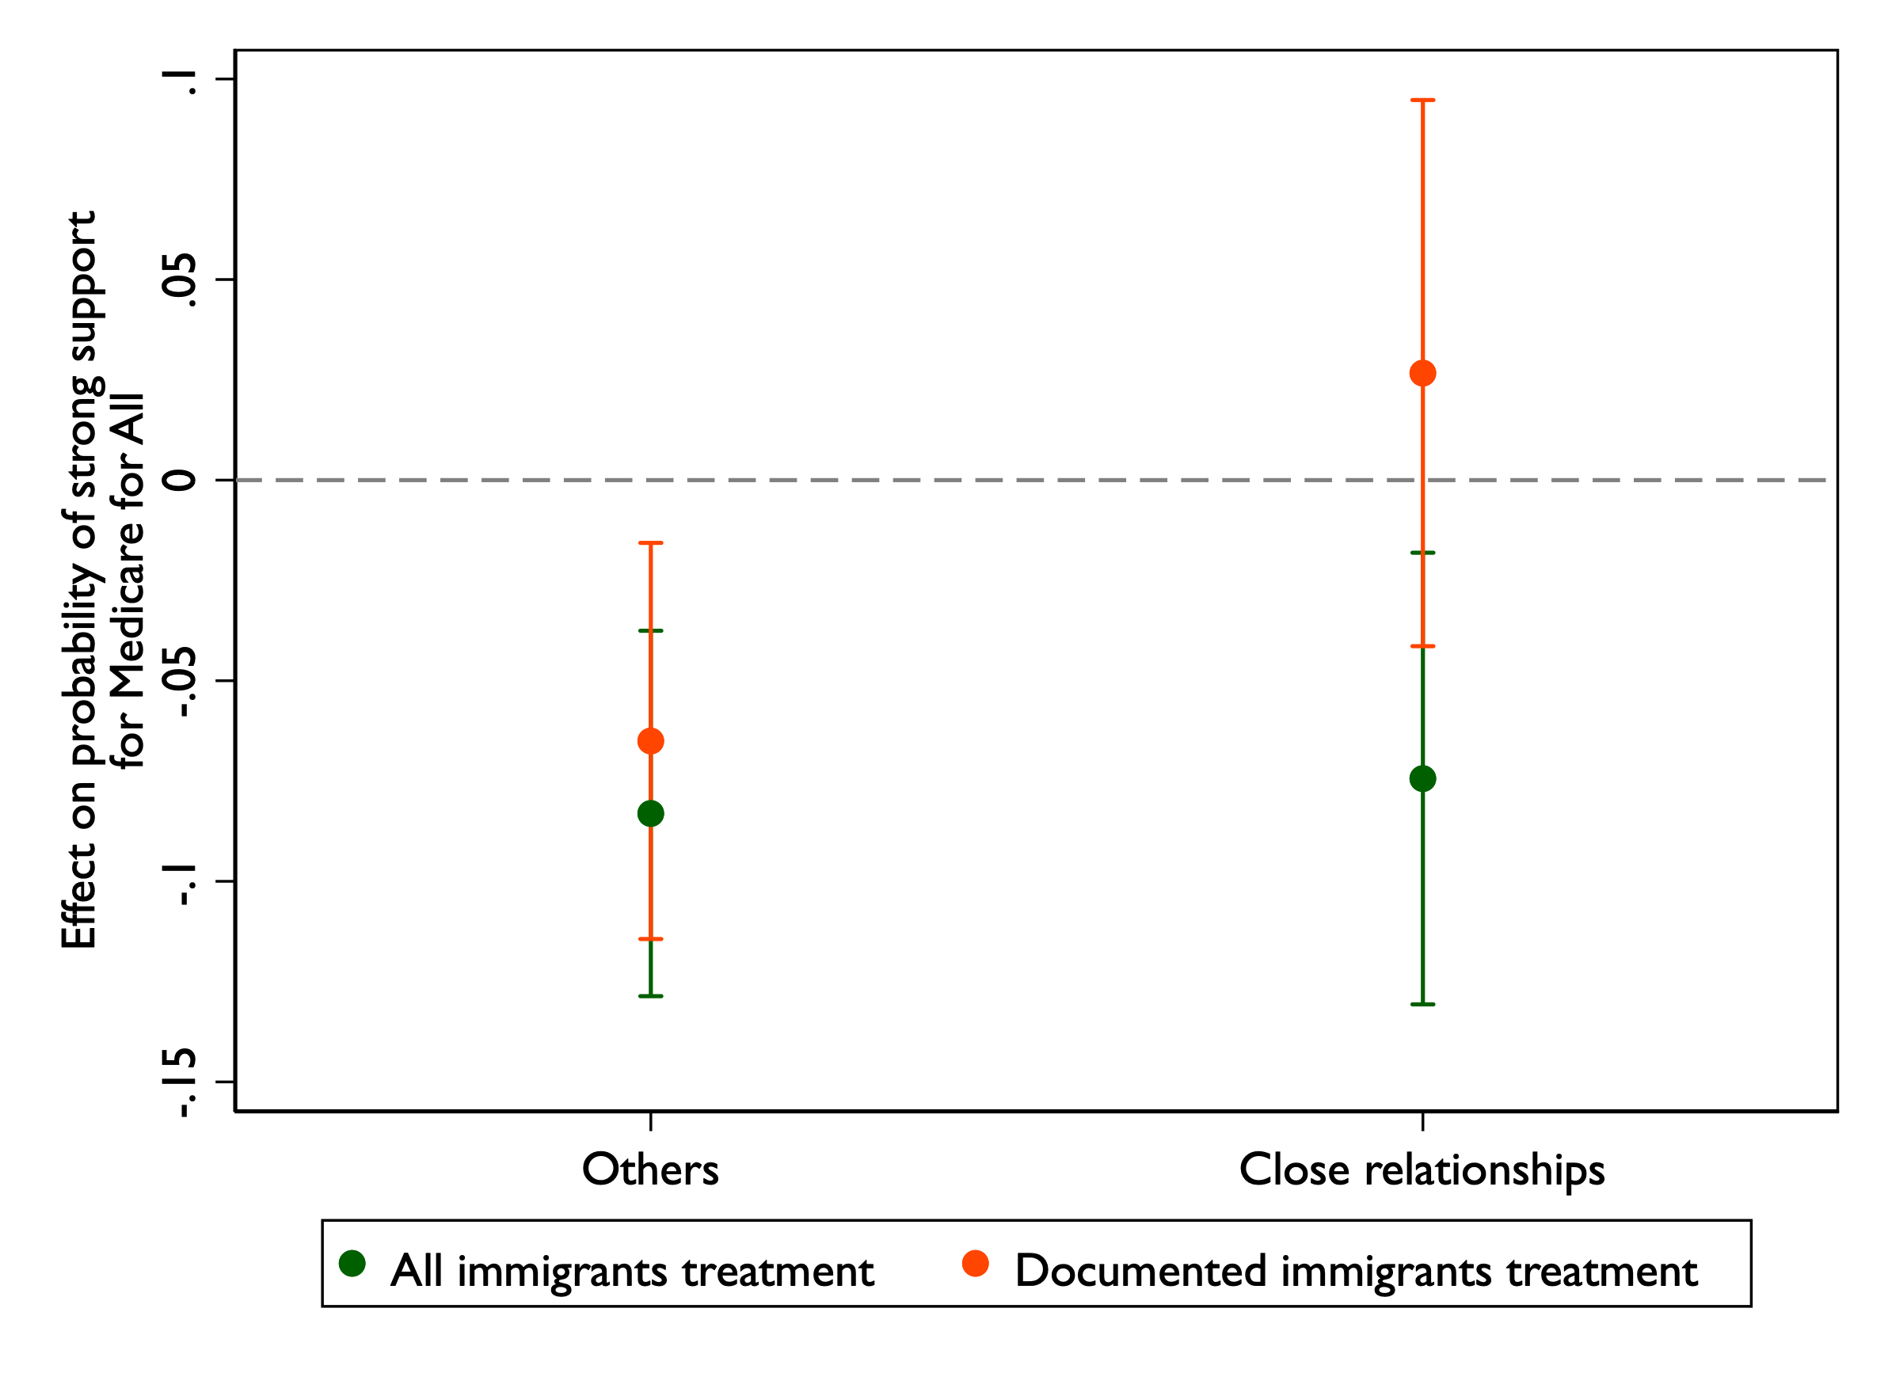
Conditional Effect Results (Personal Relationships)

Slide 12
Next Steps
Conduct another survey experiment.
Literature advice on the nature/valence of interactions or relationships with immigrants/outgroups in general?
Testing effects of interactions or relationships with immigrants on different welfare programs?
Distinguishing effects of different types of actual contact with immigrants?
And so on?

Slide 13
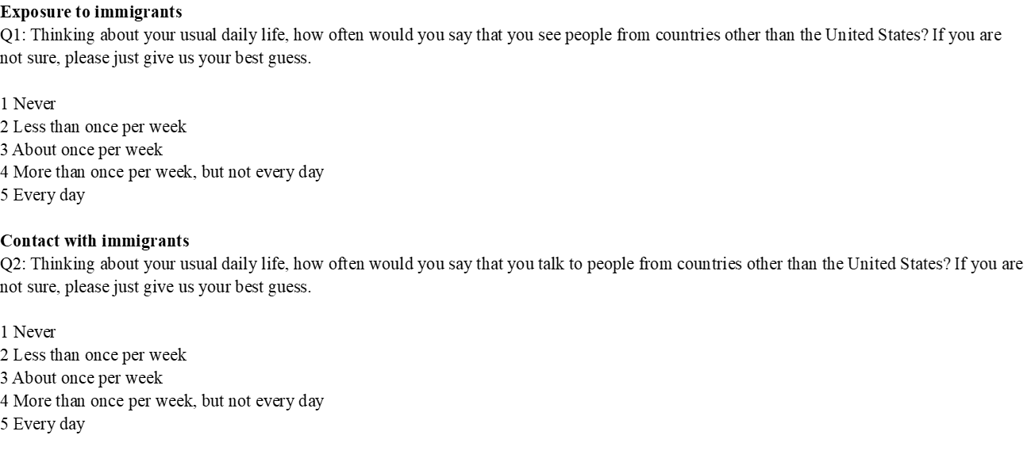
Appendix A. Core Questions and Prompts in CES Questionnaire

Slide 14
Appendix A. Core Questions and Prompts in CES Questionnaire

Slide 15
Appendix A. Core Questions and Prompts in CES Questionnaire

